Slide 1

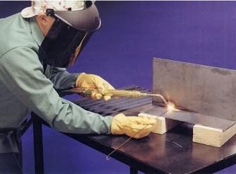
Joining Process
IC141
Even Semester February-June 2014
Lecture #11
Dr. Mohammad Talha
Asst. Professor
School of Engineering
Indian Institute of Technology Mandi
H.P., INDIA, 175 001
talha@iitmandi.ac.in

Slide 2
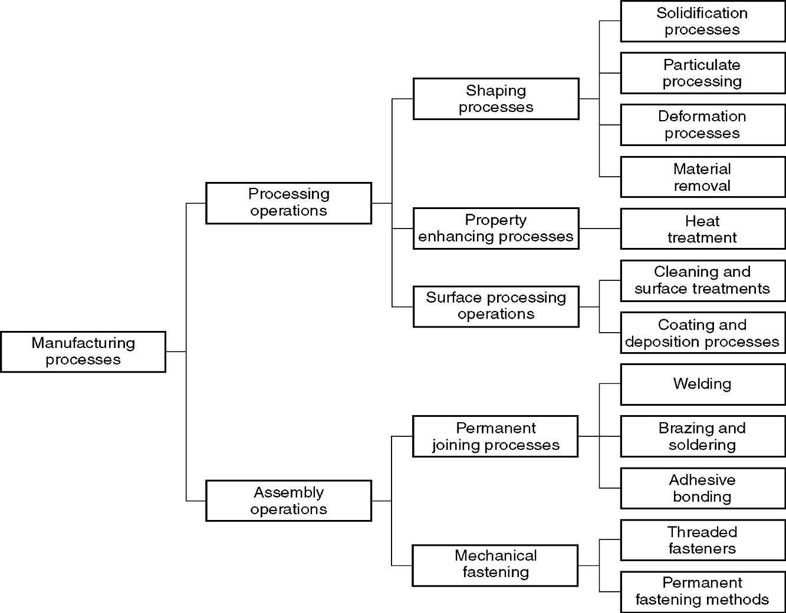

J O I N I N G

Slide 3
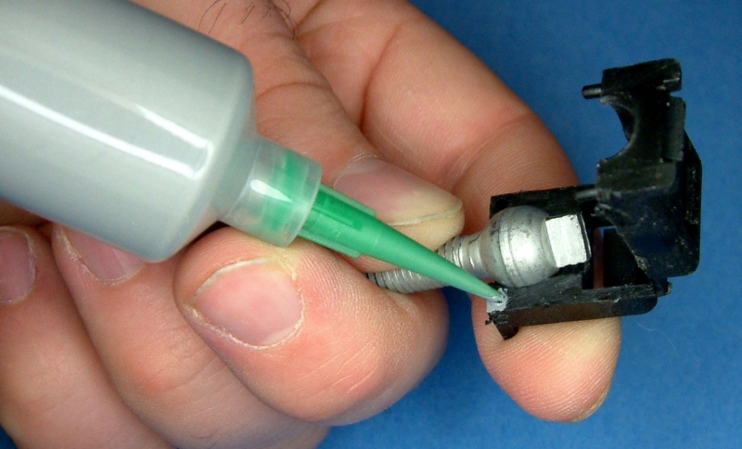
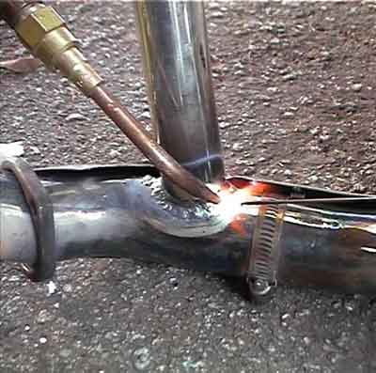
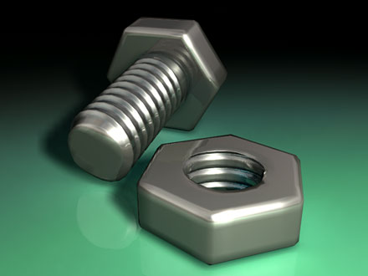
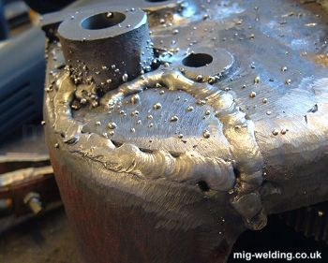
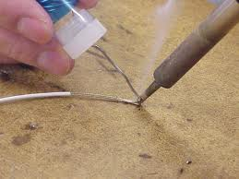
WHAT IS JOINING?
A positive (addition) process used for assembling different members to get desired the configuration.
Joint can be temporary or permanent in nature produced by mechanical or atomic bond.
ADHESIVE JOINING
GAS WELDING
BRAZE WELD
MECH. JOINTS
SOLDERING

Slide 4
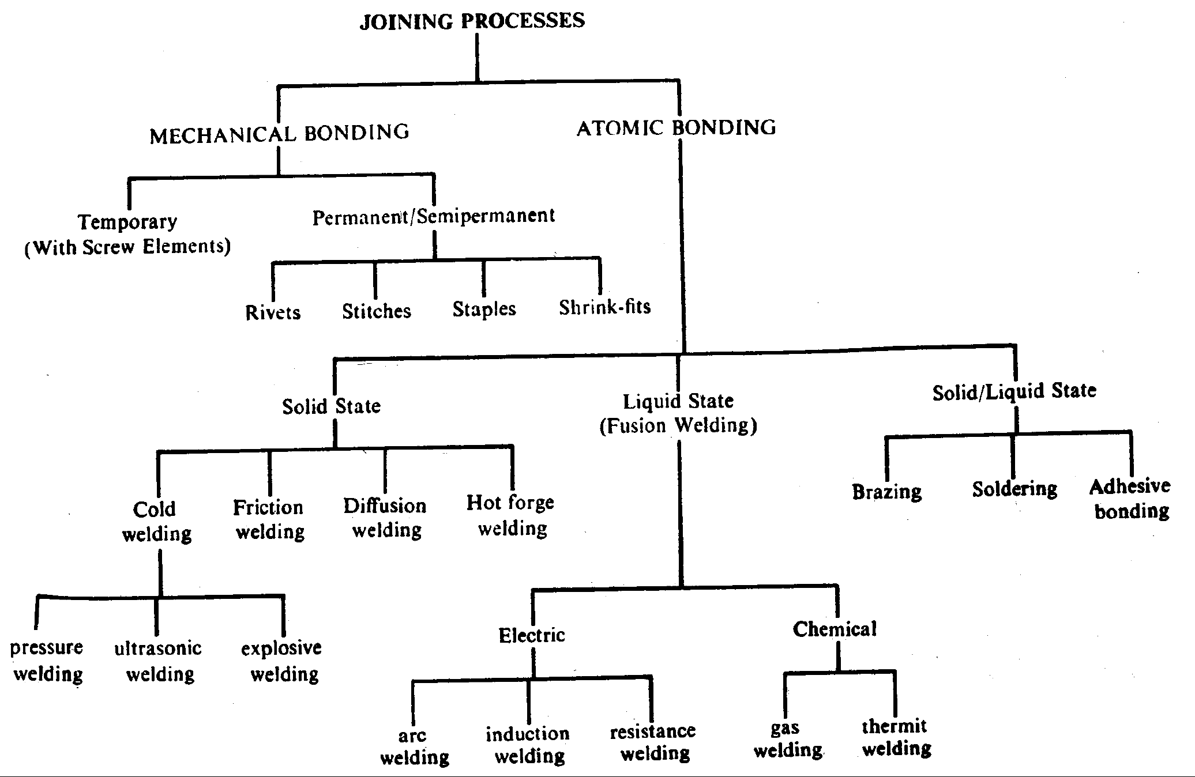
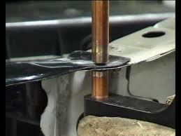
CLASSIFICATION of JOINING PROCESSES
SPOT WELD

Slide 5
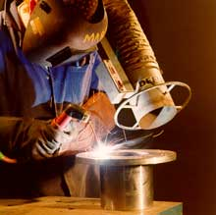
CONVENTIONAL JOINING PROCESSES
Mechanical Joining
Bond Type
Nature
Examples
Temporary
Threaded Fasteners: Screws, Nuts, Bolts
Permanent or
Semi-permanent
Riveting and Crimping
Press/Shrink Fit: Pulley, Gear on Shaft
Sewing, Stitching, Stapling: for, cloths, Leather, thin plastics

Slide 6
A Brief History of Welding
Late 19th Century
  Scientists/engineers apply advances in electricity to heat and/or join metals (Le Chatelier, Joule, etc.)
Early 20th Century
  Prior to WWI welding was not trusted as a method to join two metals due to crack issues
1930’s and 40’s
  Industrial welding gains acceptance and is used extensively in the war effort to build tanks, aircraft, ships, etc.
Modern Welding
  the nuclear/space age helps bring welding from an art to a science

Slide 7
Early Developments in Welding
Edmund Davy discovered acetylene at beginning of nineteenth century
Sir Humphrey Davy discovered the electric arc
in 1801
  Concerned with use of arc for illumination
  Demonstrated possible to maintain high voltage arc for varying periods of time by 1809
Workable electrical generating devices invented and developed on practical basis by 1850
These inventions were forerunner of
present arc welding process.

Slide 8
History of Fusion Welding
First documented instance done by Auguste de Meritens in 1881
  Welded lead battery plates together with carbon electrode
Two of Auguste's pupils, N. Benardos and S. Olszewski continued work and issued patent for welding process using carbon electrodes and electric power source four years later
  Primary goal was repair welding

Slide 9
Bare Metal Electrode Welding
Introduced in 1888 by N. G. Slavianoff (Russian)
  Discovery first recognized in western Europe in 1892
C. L. Coffin was pioneer of welding industry in United States
  1889 received patent on equipment and process for flash-butt welding
  1890 received additional patents for spot welding
  1892 received patent for bare metal electrode arc welding process
    Without knowledge of Slavianoff's work

Slide 10
Development of Modern Welding
Design of welding machines changed very little during postwar period
  Done with d.c. current from batteries
Use of a.c. welding machines occurred in late 1920 and increased in the early 1930s
  First high frequency a.c. industrial machine introduced in 1936 by Miller Electric Manufacturing Company
  High rate of metal deposition and absence of arc blow

Slide 11
Industry Demand
Over 90 welding processes
Force new and improved developments in machines, gases, torches, electrodes, procedures, and technology
Constant research for new metals done by shipbuilding, space and nuclear industries
  Spurs research in welding

Slide 12
Welding Associations
American National Standards Institute (ANSI)
American Petroleum Institute (API)
American Society of Mechanical Engineers (ASME)
American Welding Society (AWS)
American Bureau of Shipping (ABS)
Provide guidance and standards relating
to the welding industry.

Slide 13
WELDING
Process of joining similar metals by application of heat
with or without application of pressure and
with or without addition of filler material.
The filler metal has melting point approximately the same as the base metals
Advantage :
Welding results in a good saving of material and reduced labour content of production.
Low manufacturing Costs.
It gives the designer great latitude in planning and designing.
Without welding techniques, the light weight methods of fabrications, so vital to the automotive and aircraft industries , would be unthinkable

Slide 14
Disadvantage :
Welding Procees required Skilled labour
Most of welding processes are dangerous beause they involve the use of high energy
Since welding process accomplishes a permanent bond between the components, it does not allow for convient dissembly

Slide 15
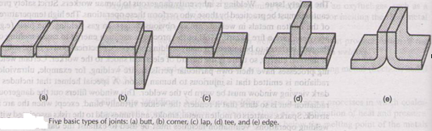
TYPE OF JOINT

Slide 16
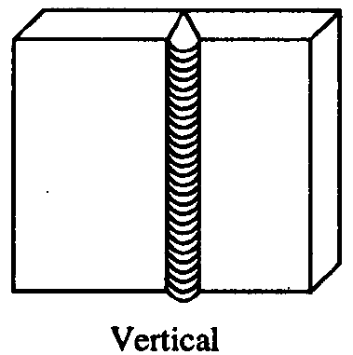
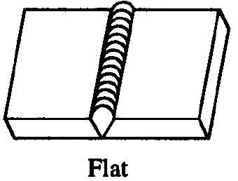
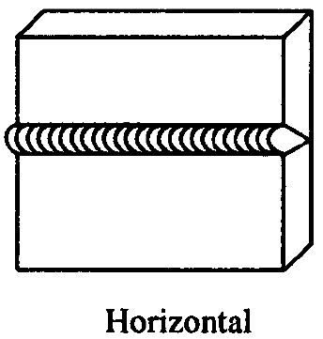
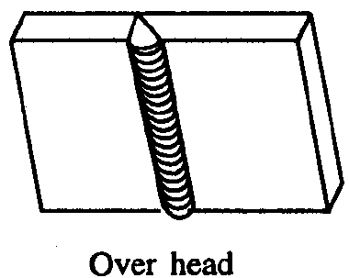
TYPES OF WELDING POSITIONS

Slide 17
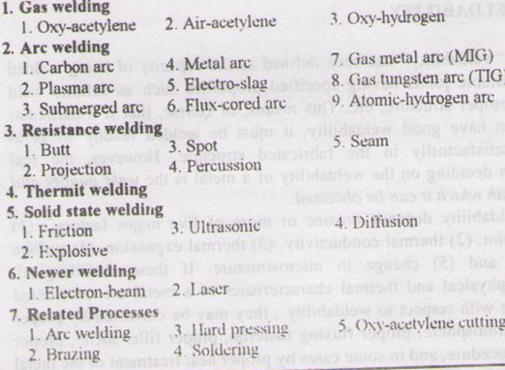
TYPE OF WELDING PROCESS

Slide 18
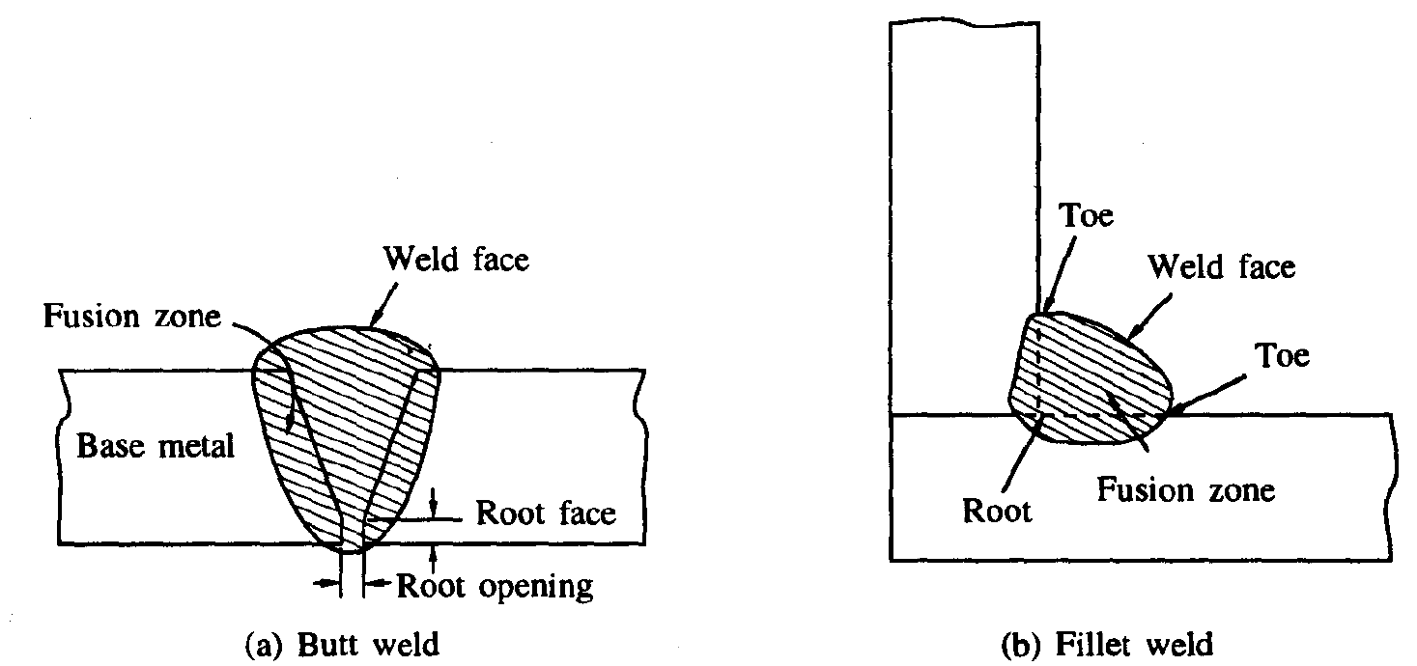
COMMON WELDING TERMS

Slide 19
COMMON WELDING TERMS
Backing: It is the Material Support Provided at the Root Side of a Weld to Aid in the Control Of Penetration.
Base Material: The Material to be Joined or Cut is Termed as the Base Material.
Bead or Weld Bead: Bead is the Material Added during a Single Pass of Welding. The Bead Appears as a Separate Material From the Base Material.
Crater: In Arc Welding, a Crater is the Depression in the Weld Material Pool at the Point Where the Arc Strikes the Base Material.

Slide 20
COMMON WELDING TERMS
Deposition Rate: The Rate at which the Weld Material is Deposited Per Unit Time, is the Deposition Rate and is Normally Expressed as Kg Per Hour.
Fillet Weld: The Metal Fused into the Corner of a Joint Made of Two Pieces Placed at Approximately 90° to Each Other is Termed Fillet Weld.
Puddle: The Portion of the Weld Joint that Melted by the Heat of Welding is Called Puddle.
Root: It is the Point at which the Two Pieces to be Joined by Welding are Nearest.

Slide 21
Tack Weld: A Small Weld, Generally Used to Temporarily Hold the Two Pieces Together during Actual Welding, is the Tack Weld.
Toe of Weld: It is the Junction Between the Weld Face and Base Material.

Slide 22
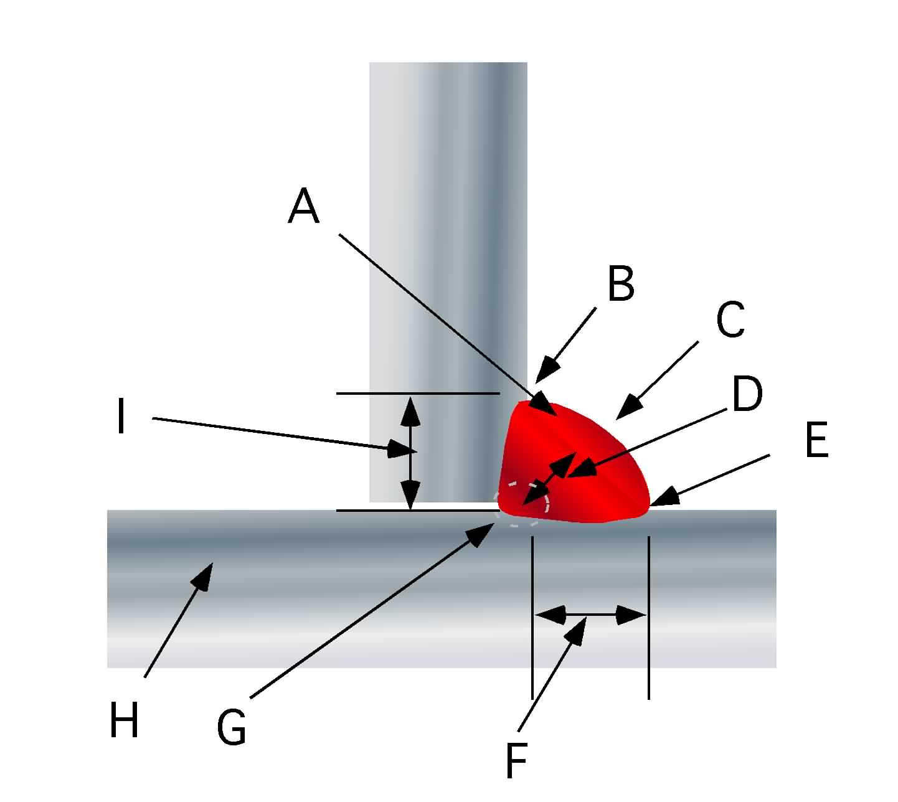
Fillet welds have a triangular cross section and are used to fuse two faces of metal that are at a 90 degree angle to each other.
Three common types are:
Fillet Welds
T
Lap
Corner
A: Reinforcement
B: Toe
C: Face
D: Throat
E: Toe
F: Leg
G: Root
H: Base metal
I: Leg

Slide 23
Torch: In Gas Welding, the Torch Mixes the Fuel and Oxygen and Controls its Delivery to Get the Desired Flame.
Weld Face: It is the Exposed Surface of the Weld
Weld Material: The Material that is Solidified in the Joint is Called Weld Material. It may be only Base Material or a Mixture of Base Material and Filler Material.
Weld Pass: A Single Movement of the Welding Torch or Electrode Along the Length of the Joint which Results in a Bead, is a Weld Pass.

Slide 24
Weldability of a Metal
Metallurgical Capacity
  Parent metal will join with the weld metal without formation of deleterious constituents or alloys
Mechanical Soundness
  Joint will be free from discontinuities, gas porosity, shrinkage, slag, or cracks
Serviceability
  Weld is able to perform under varying conditions or service (e.g., extreme temperatures, corrosive environments, fatigue, high pressures, etc.)

Slide 25

Fusion Welding
ELECTRODE COATING
CORE WIRE
WELDING ATMOSPHERE
ARC STREAM
ARC POOL
SOLIDIFIED SLAG
PENETRATION DEPTH
WELD
BASE METAL

Slide 26
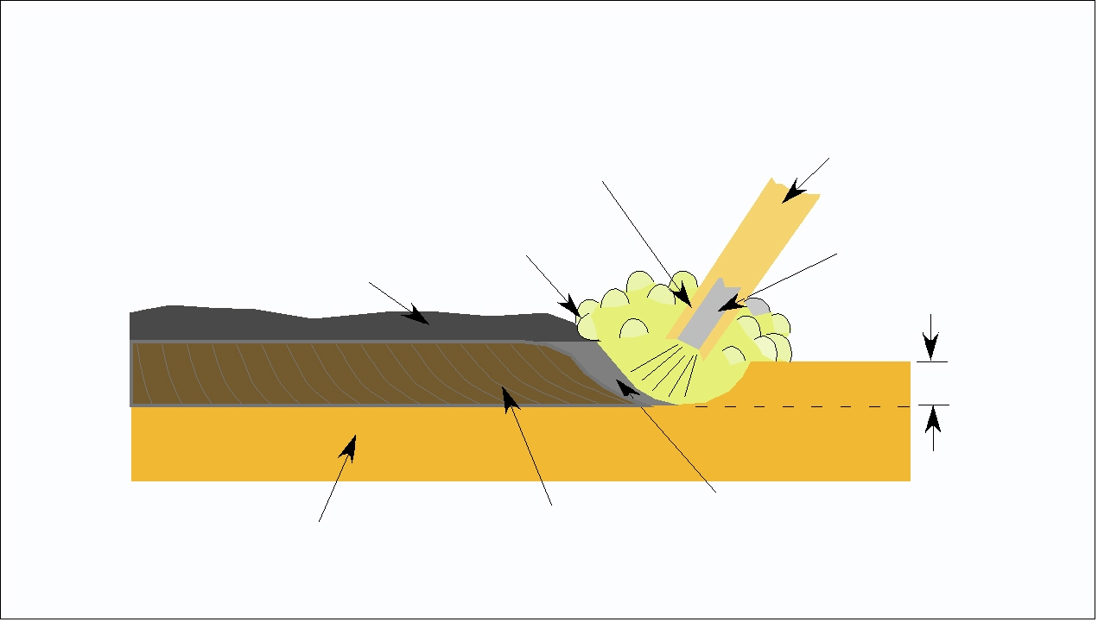
Fusion Welding Nomenclature
Flux
Electrode
Gas
shield
Electrode
metal
Slag
Penetration
Bead
Molten
puddle
Base metal

Slide 27
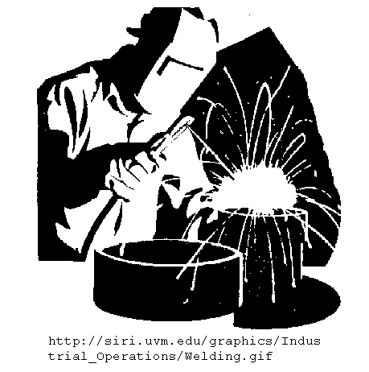
Definition:
Fusion welding is a
group of processes that
bond metal together by
heating a portion of each piece above the melting point and causing them to
flow together.
    Usually includes the uses a filler material to insure the joint is filled.

Slide 28
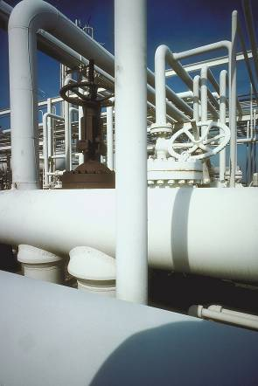
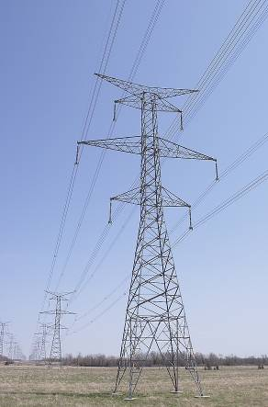
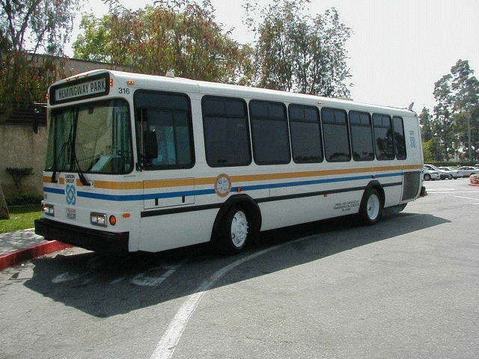
Why is Welding Important?
Many things around us are welded …
  Pipelines that bring fresh water
  Towers that carry electricity to houses
  Cars and buses that take people where they need to go

Slide 29
Fusion Welding Requirements
All fusion welding processes have four requirements.
  Heat
  Shielding
  Filler material
  Critical distance

Slide 30
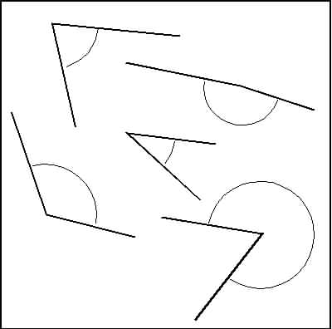
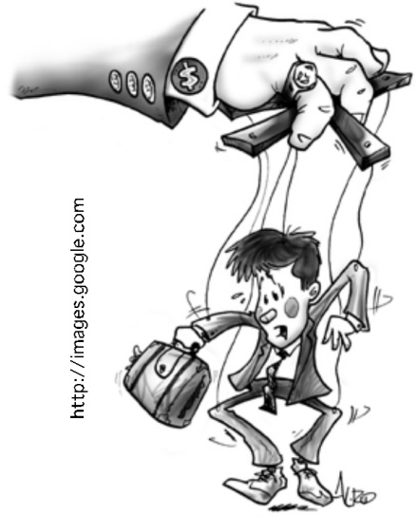


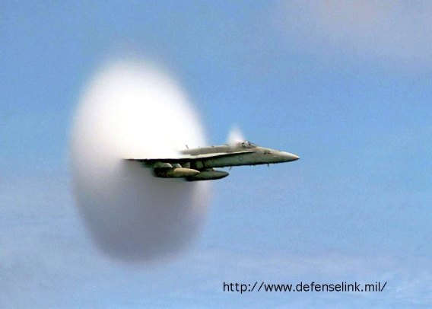
Fusion Welding’s Five (5) Factors Which Determine The Quality Of The Weld
Manipulation
Angle
Heat
Speed
Distance

Slide 31
Fusion Welding Principles
Base metal is melted
Filler metal may be added
Heat is supplied by various means
  Oxyacetylene gas
  Electric Arc
  Plasma Arc
  Laser

Slide 32
Weld Metal Protection
During fusion welding, the molten metal in the weld “puddle” is susceptible to oxidation
Must protect weld puddle (arc pool) from the atmosphere
Methods
  Weld Fluxes
    Inert Gases
      Vacuum

Slide 33
Weld Fluxes
Typical fluxes
  SiO₂, TiO₂, FeO, MgO, Al₂O₃
  Produces a gaseous shield to prevent contamination
  Act as scavengers to reduce oxides
  Add alloying elements to the weld
  Influence shape of weld bead during solidification

Slide 34
Inert Gases
Argon, helium, nitrogen, and carbon dioxide
Form a protective envelope around the weld area
Used in
  MIG
  TIG
  Shield Metal Arc

Slide 35
Vacuum
Produce high-quality welds
Used in electron beam welding
Nuclear/special metal applications
  Zr, Hf, Ti
Reduces impurities by a factor of 20 versus other methods
Expensive and time-consuming

Slide 36
Types of Fusion Welding
Oxyacetylene Cutting/Welding
Shielded Metal Arc
Metal Inert Gas (MIG)
Tungsten Inert Gas (TIG)

Slide 37
Oxyacetylene Welding
Flame formed by burning a mix of acetylene (C₂H₂) and oxygen
Fusion of metal is achieved by passing the inner cone of the flame over the metal
Oxyacetylene can also be used for cutting metals
TORCH TIP
2300 deg F
Inner Cone: 5000-6300 deg F
Combustion Envelope 3800 deg F

Slide 38
Shielded Metal Arc
An electric arc is generated between a coated electrode and the parent metal
The coated electrode carries the electric current to form the arc, produces a gas to control the atmosphere and provides filler metal for the weld bead
Electric current may be AC or DC. If the current is DC, the polarity will affect the weld size and application

Slide 39
Shielded Metal Arc (con’t)
Process:
  Intense heat at the arc melts the tip of the electrode
  Tiny drops of metal enter the arc stream and are deposited on the parent metal
  As molten metal is deposited, a slag forms over the bead which serves as an insulation against air contaminants during cooling
  After a weld ‘pass’ is allowed the cool, the oxide layer is removed by a chipping hammer and then cleaned with a wirebrush before the next pass.

Slide 40
Inert Gas Welding
For materials such as Al or Ti which quickly form oxide layers,
Method to place an inert atmosphere around the weld puddle had to be developed

Slide 41
Metal Inert Gas (MIG)
Uses a consumable electrode (filler wire made of the base metal)
Inert gas is typically Argon
CONSUMABLE ELECTRODE
DRIVE WHEELS
POWER SOURCE
SHIELDING GAS
ARC COLUMN
BASE METAL
PUDDLE

Slide 42
Tungsten Inert Gas (TIG)
Tungsten electrode acts as a cathode
A plasma is produced between the tungsten cathode and the base metal which heats the base metal to its melting point
Filler metal can be added to the weld pool
TUNGSTEN ELECTRODE
(CATHODE)
TUNGSTEN ELECTRODE
POWER SOURCE
+ +
+ +
SHIELDING GAS
ARC COLUMN
- - -
BASE METAL
PUDDLE
BASE METAL (ANODE)

Slide 43
Advantages and Disadvantages of GTAW
Advantages:
High quality welds for suitable applications
No spatter because no filler metal through arc
Little or no post-weld cleaning because no flux
Disadvantages:
Generally slower and more costly than consumable electrode AW processes

Slide 44
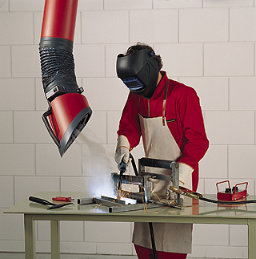
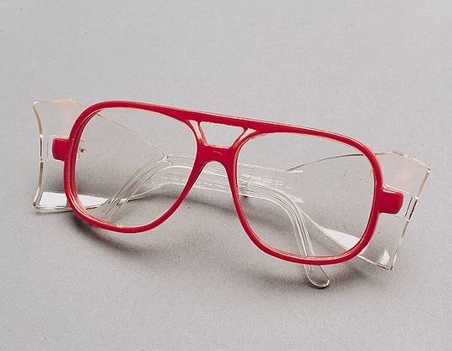
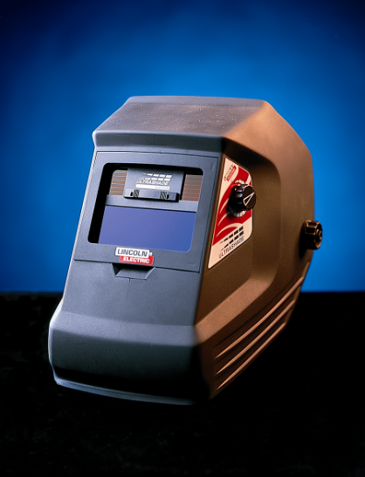
Arc Welding Safety
Protect yourself and others from potential hazards including:
  Fumes and Gases
  Electric Shock
  Arc Rays
  Fire and Explosion Hazards
  Noise
  Hot objects

Slide 45
Five Types of Joints
Corner
Butt
Lap
T
Edge

Slide 46
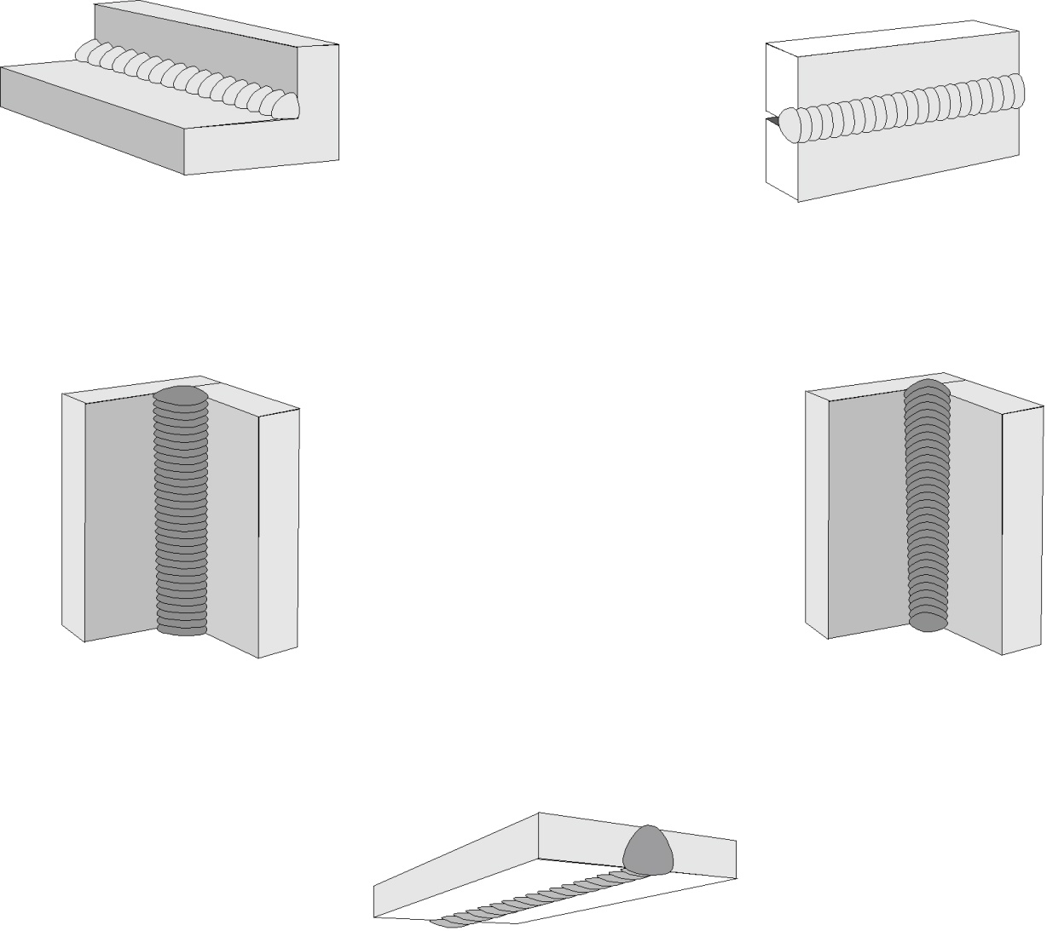
Five Welding Positions
Flat
Horizontal
Vertical up
Vertical down
Overhead

Slide 47
Welding Defects
Cracks
Cavities
Solid inclusions
Imperfect shape or unacceptable contour
Incomplete fusion
Miscellaneous defects

Slide 48
Welding Cracks
Fracture‑type interruptions either in weld or in base metal adjacent to weld
Serious defect because it is a discontinuity in the metal that significantly reduces strength
Caused by embrittlement or low ductility of weld and/or base metal combined with high restraint during contraction
In general, this defect must be repaired

Slide 49
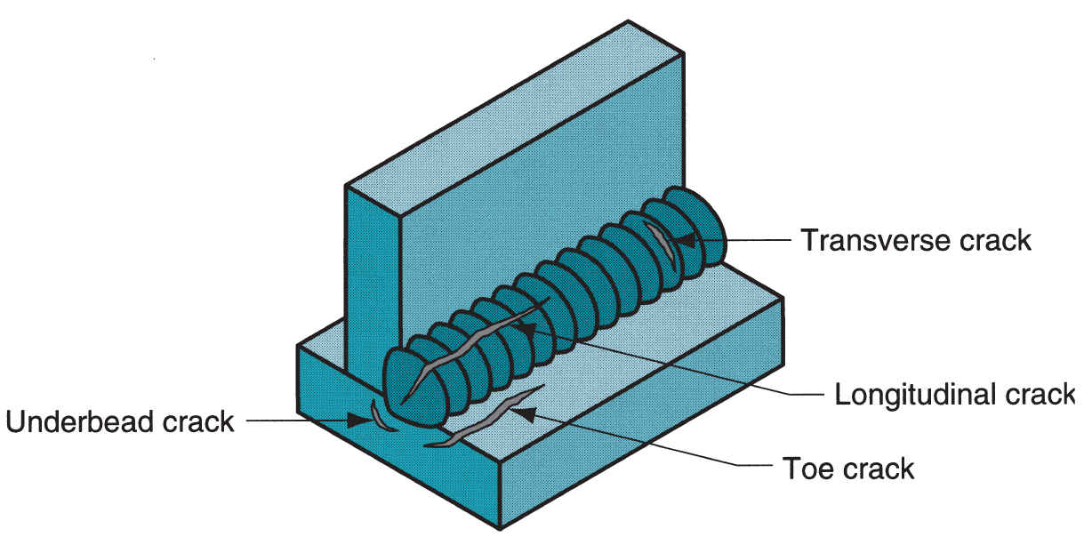
Welding Cracks
Various forms of welding cracks

Slide 50
Cavities
Two defect types, similar to defects found in castings:
Porosity - small voids in weld metal formed by gases entrapped during solidification
  Caused by inclusion of atmospheric gases, sulfur in weld metal, or surface contaminants
Shrinkage voids - cavities formed by shrinkage during solidification

Slide 51
Solid Inclusions
Nonmetallic material entrapped in weld metal
Most common form is slag inclusions generated during AW processes that use flux
  Instead of floating to top of weld pool, globules of slag become encased during solidification
Other forms: metallic oxides that form during welding of certain metals such as aluminum, which normally has a surface coating of Al₂O₃

Slide 52
Solid Inclusions
Nonmetallic material entrapped in weld metal
Most common form is slag inclusions generated during AW processes that use flux
  Instead of floating to top of weld pool, globules of slag become encased during solidification
Other forms: metallic oxides that form during welding of certain metals such as aluminum, which normally has a surface coating of Al₂O₃

Slide 53
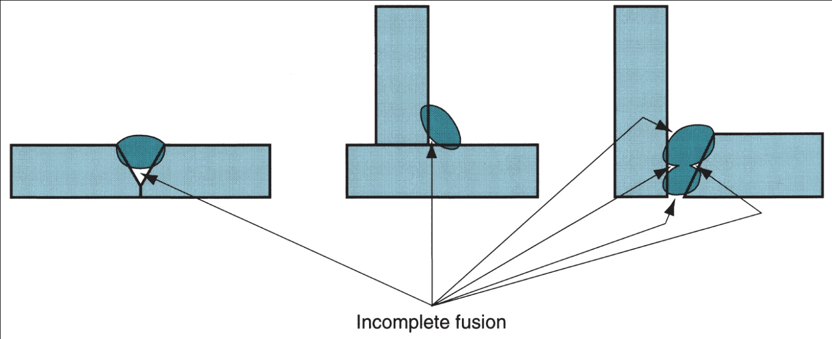
Incomplete Fusion
A weld bead in which fusion has not occurred throughout entire cross section of joint
Several forms of incomplete fusion are shown below

Slide 54
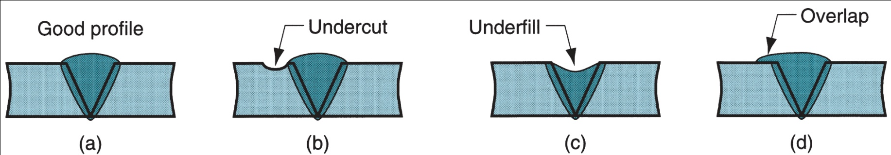
Weld Profile in AW
(a) Desired profile for single V-groove weld joint, (b) undercut - portion of base metal melted away, (c) underfill - depression in weld below adjacent base metal surface, and (d) overlap - weld metal spills beyond joint onto part surface but no fusion occurs

Slide 58
Lecture presented herein are taken from different sources
like Internet, books, etc.
End of lecture #11

